Slide 1
Hospitals Routes Finder
21K-4598 Salman Ali
21K-3336 Hassan Shahbaz
21K-3164 Asad Jaffer

Slide 2
Overview
The Hospitals Routes Finder project aims to develop a system that leverages Dijkstra's algorithm to optimize and streamline the routes within a hospital, enhancing overall accessibility and minimizing travel times.
Optimized Navigation
User-Friendly
Scalability

Slide 3
Problem Statement
In many hospitals, the lack of an efficient navigation system contributes to delays, confusion, and increased stress for patients, visitors, and healthcare professionals. Traditional signage may not be sufficient, especially in large and complex hospital layouts. This project addresses the following challenges:
Inefficient Navigation
Resource Optimization
User Experience

Slide 4
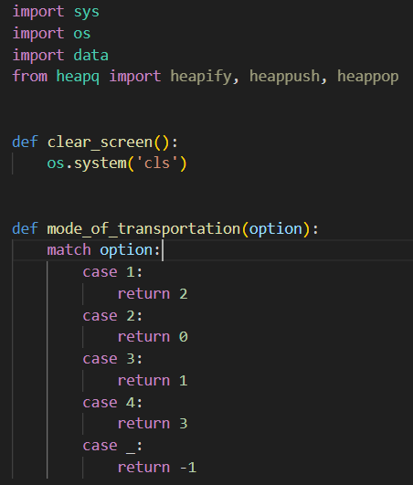
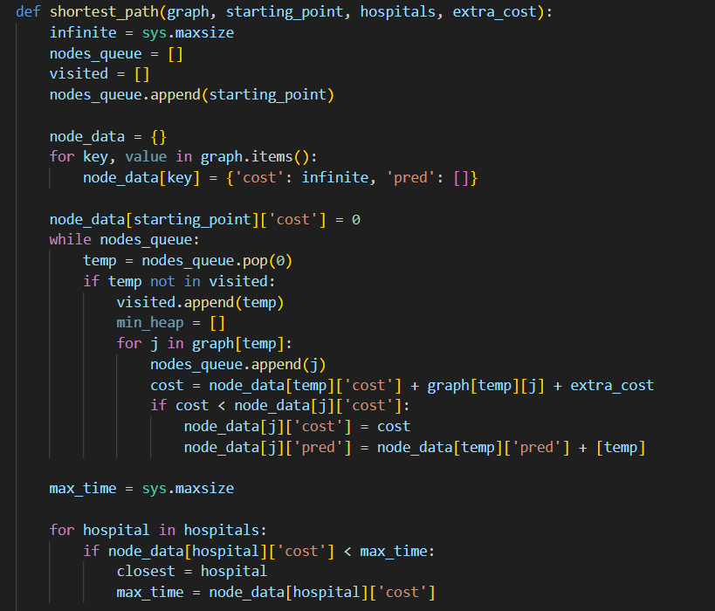


Slide 5
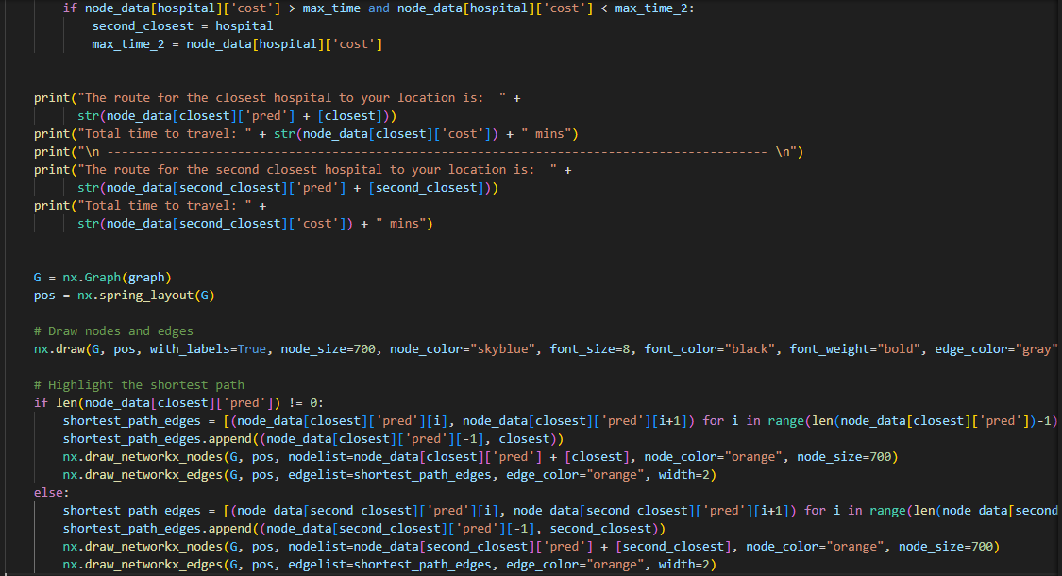
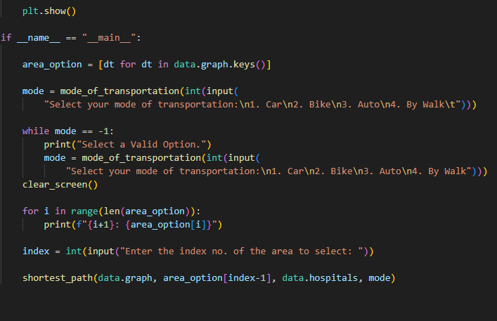

Slide 6
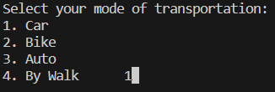
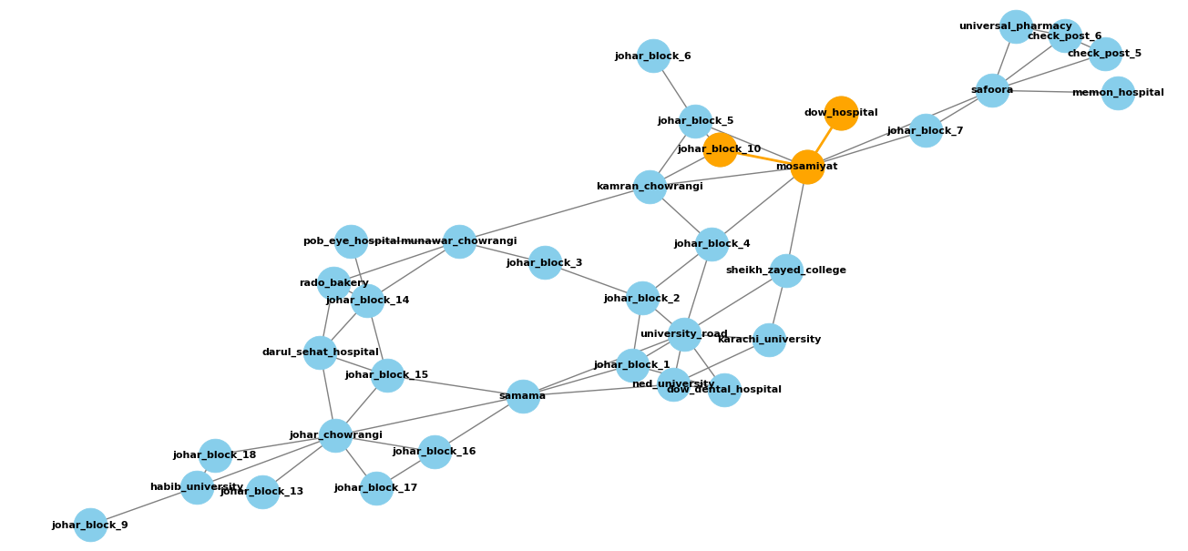
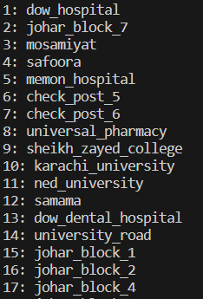
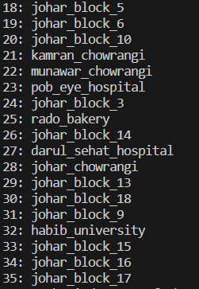
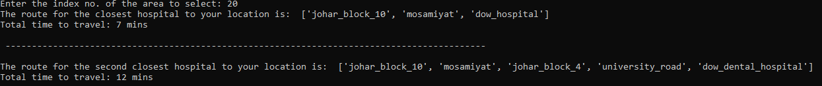
Inputs & Outputs

Slide 7
conclusion
the Hospitals Routes Finder project not only seeks to solve the immediate problems associated with inefficient navigation within hospitals but also strives to contribute to the broader goals of enhancing emergency response, optimizing resource utilization, and ultimately improving the overall quality of care within healthcare facilities. As technology continues to play a pivotal role in shaping the healthcare landscape, this project represents a significant step toward creating a more patient-centric, efficient, and responsive hospital environment.

